Slide 1
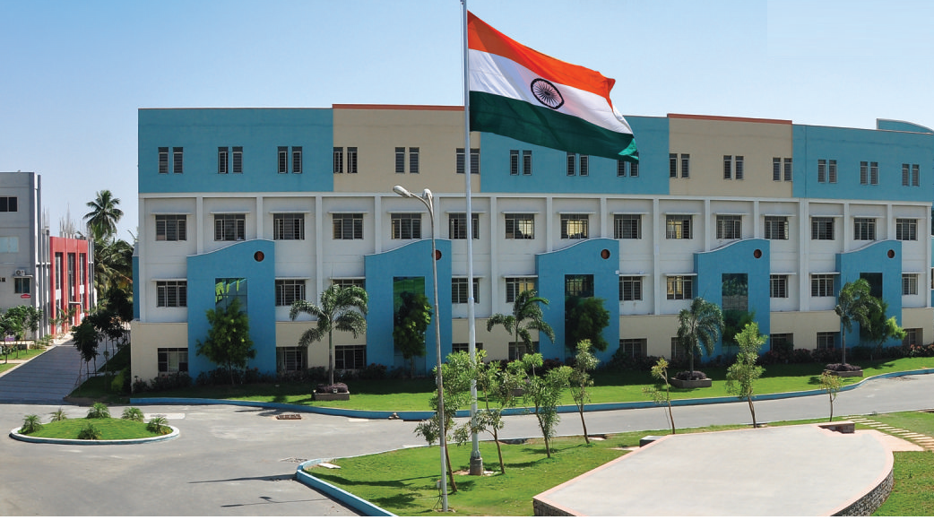
SRI ESHWAR COLLEGE OF ENGINEERING academic year: 2017-18 department: CIVIL YEAR: IV
DESIGN PROJECT REVIEW – 0
Date of review: 07/07/2017

Slide 2
Planning, Analysis & Design of A Multi Cuisine Restaurant
Batch Members
Gowtham K 14CE017
Sathish Kumar J 14CE050
Shiyam J P 14CE051
Vijay Raghavan S 15CEL007
Guide Name:
Mr. Raaj Kumar S
Asst.Prof/Civil Dept.

Slide 3
Presentation Outline
Abstract
Literature Survey
Need for the study
Work Schedule

Slide 4
Abstract of the project
The proposed Multi cuisine restaurant consists of G+2 with kids play station & underground car parking
As the steel shell roof coves the maximum volumes with the minimum larger volumes with no interrupting columns with more efficient manner.
In this project the analysis of steel shell is examine by using E-Tabs & SAP 2000.

Slide 5
Literature Survey (Cont.d)
JOURNAL | American Institute of Steel Construction, Volume 3
TITLE | Steel Shell Roof Structures
AUTHOR(S) | Arthur H. Nilson
INFERENCE | Advantages of shell structures for enclosing large, column free areas are well known. They are light in weight well suited to preassembly of all parts.

Slide 6
Literature Survey
JOURNAL | American Institute of Steel Construction, August (2005)
TITLE | Genetic Algorithms with Steel Structures
AUTHOR(S) | Robb MacDonald
INFERENCE | This section will include research improving execution time, cross over techniques, bilevel networking, fuzzy operators, and tournament selection.

Slide 7
Need for the study
In Coimbatore we are going to develop a Multi Cuisine Restaurant with a aesthetic appearance using steel shell roof structure.
To provide a luxurious comfort zone
To multi disciplinary experience in a single roof like a mini conference hall, coffee room, Tv & Wi-Fi connectivity in every rooms, car parking, lodging, etc.

Slide 8
Work Schedule
S.NO | DATE | WORK TO BE DONE | REMARKS
1 | 03/07/2017 | Selection of Topic | .
2 | 07/07/2017 | Collection of Literatures | .
3 | 15/07/2017 | Planning using Revit | .
4 | 19/08/2017 | Analysis & Designing by E-Tabs & SAP 2000. | .
5 | 18/09/2017 | Generation of reports | .
6 | 22/09/2017 | Preparation of books | .
7 | 28/09/2017 | Submission of book | .

